Slide 1
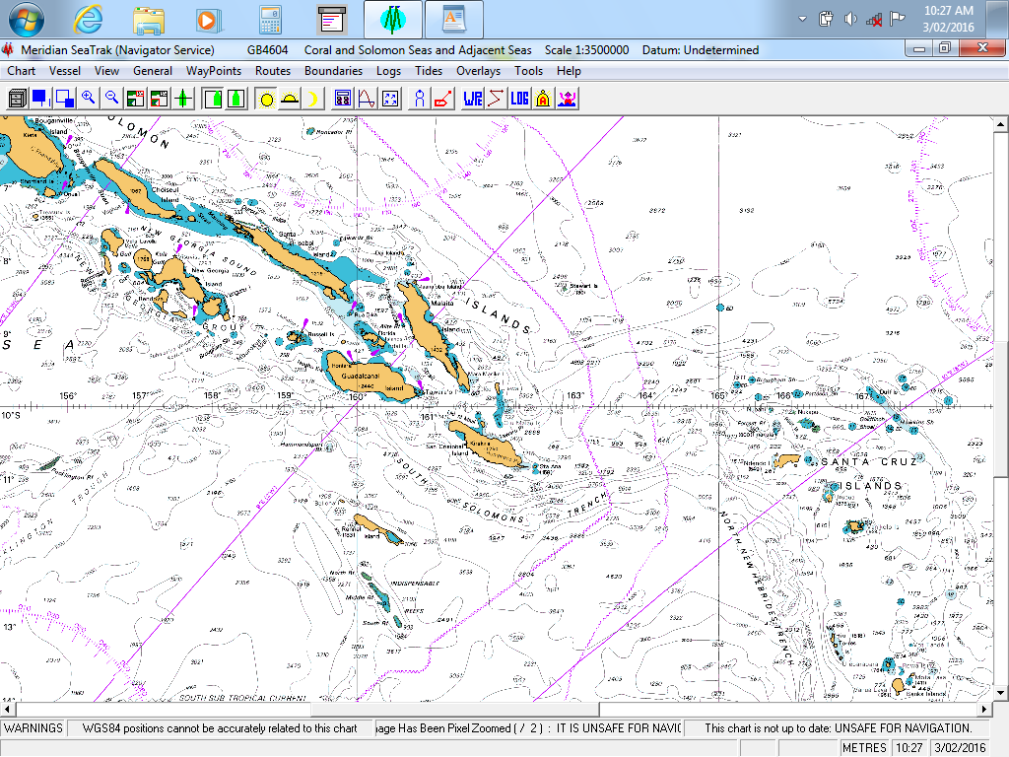
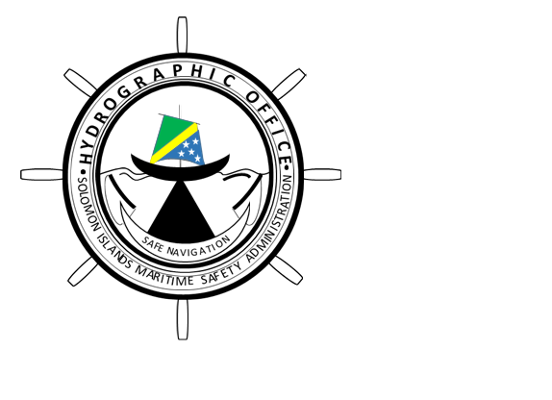
16th Meeting of the South West Pacific Hydrographic Commission National Report by
Solomon Islands Hydrographic Unit
SIMSA / SIMA

Slide 2
Main achievements during the year
AHS – Taking on the role of PCA for Solomon Islands as of
11 August 2017, (MOU signed on 28 September 2017),
Provision of Nautical Charts with SI National numbers (SLB) now available at the SIHU. SI ENCs are also available through PCAs recommended distributors overseas.
Recently the new SITT 2019 was published and is now available.
SIMSA – will become SIMA after the passage of the Maritime Act 2018 in Parliament on 31 August 2018.

Slide 3
Main challenges and/or obstructions
Funding – Slow process in accessing govt. funds to undertake surveys,
- To cover cost of equipment repairs and maintenance overseas.
Staff Shortage – no recruitment of staff although requested through HRM Division, MID
The need for technical “On Job Training” (OTJ) on Surveying and Charting software and equipment,
Slow or no responses from stakeholders or agencies when requesting information eg. Fisheries on FADs, Port information on new wharf constructions etc,

Slide 4
Progress on surveys, charting and MSI
Surveys: Progress is slow, although there is a Work program is in place. Several other requests were received from Tourism Division for Cruise Ship visits, anchorages, new Port developments in other provinces,
Charting: - No Charting activities planned,
- Proposed surveys of “Unsurveyed Areas” to be done to update
current charts
MSI: - SIHU, AtoN Unit and MRCC currently working together in collecting,
compiling and dissemination of MSI/NMs,
- Two MRCC Officers currently doing a 2 weeks OJT with AMSA.

Slide 5
Contributions to the IHO DCDB and GEBCO
Currently no contribution is made to the above.

Slide 6
Progress on MSDI
Governance
Standards
Technology
Data
SIHU – Currently not yet in a position to develop its MSDI, although sees it as a very important development,
- may require assistance from PCA, SWPHC etc., to establish such capabilities within it’s Office, eg. Legislations, Compliance, Financial support that may be required etc….

Slide 7
Plans that affect the region
Internally we have no further plans that may affect the region.

Slide 8
Lessons learned to share
SI not yet a Member State of the IHO – accessibility to Capacity Building Programs is limited, except thru SWPHC membership,
Working together cooperatively & Sharing of information.

Slide 9
Success stories to share
Refer to the achievements earlier indicated in Slide 2 of the presentation.
Working together as a team has resulted in a 1st Cruise ship visit to Tavanipupu (Eastern most end of Guadalcanal) – 28th November 2018.

